Slide 1
CS 520 Data Curation Project MovieLens Dataset
Group 25

Slide 2




Introduction
MovieLens is a collection of datasets which contains ratings and metadata regarding various movies that users have watched.
It is composed of the following 4 datasets:
Movies: ∙
Links
Ratings
Ratings
Tags
Tags
Synthetically modified (movieId and userId) in tags and movies to introduce complexity.

Slide 3
DESIRED OUTCOME
Source Schemas:
Movies:
MovieId (string)
Title (string)
Genre (string separated by ‘|’)
Ratings:
UserId (int)
MovieId (int)
Rating (float, discrete)
Tags:
userId|movieId (string separated by ‘|’)
Tag (string)
Links:
movieId (int),
imdbId (int)
tmdbId (int)
Target Schema:
MovieRatings:
MovieId (int)
UserId (int)
imdbId (int)
tmdbId (int)
Title (string)
Tag (string)
Rating (float)
Genre_1 (int, binary)
…
Genre_n (int, binary)
The goal is to have a dataset with a slightly “friendlier” schema for a Machine Learning Context.
Schema Mapping

Slide 4
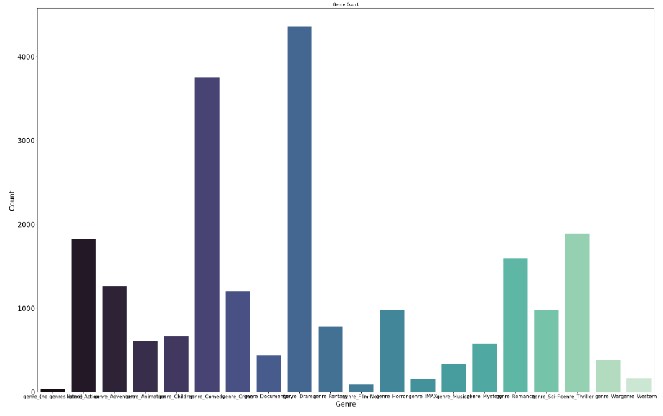
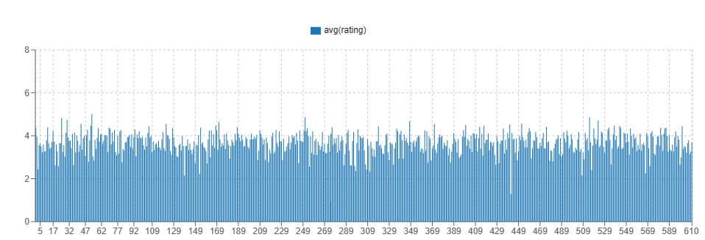
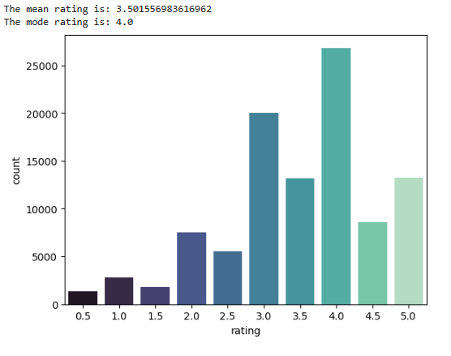
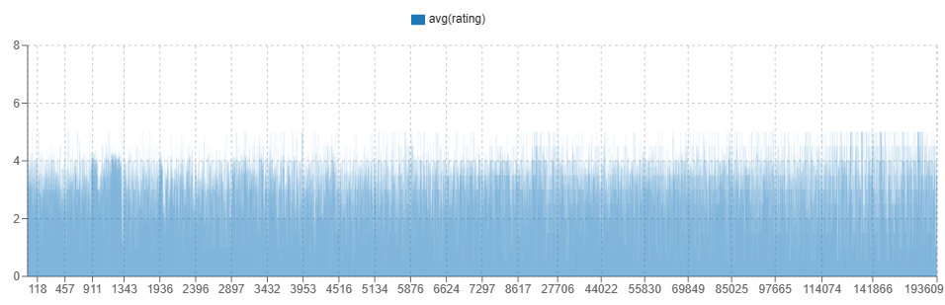
EDA
Ratings grouped by userId (vizier)
Ratings grouped by movieId (vizier)

Slide 5

Data Quality Issues
Missing values in the links DataFrame (tmdbId)
Genres are all contained in one column, we want to take a step towards a “ML” friendly dataset (BinaryEncoded).
ID’s not consistently represented, INT, and STRING.
No constraint violations (no rows returned):

Slide 6
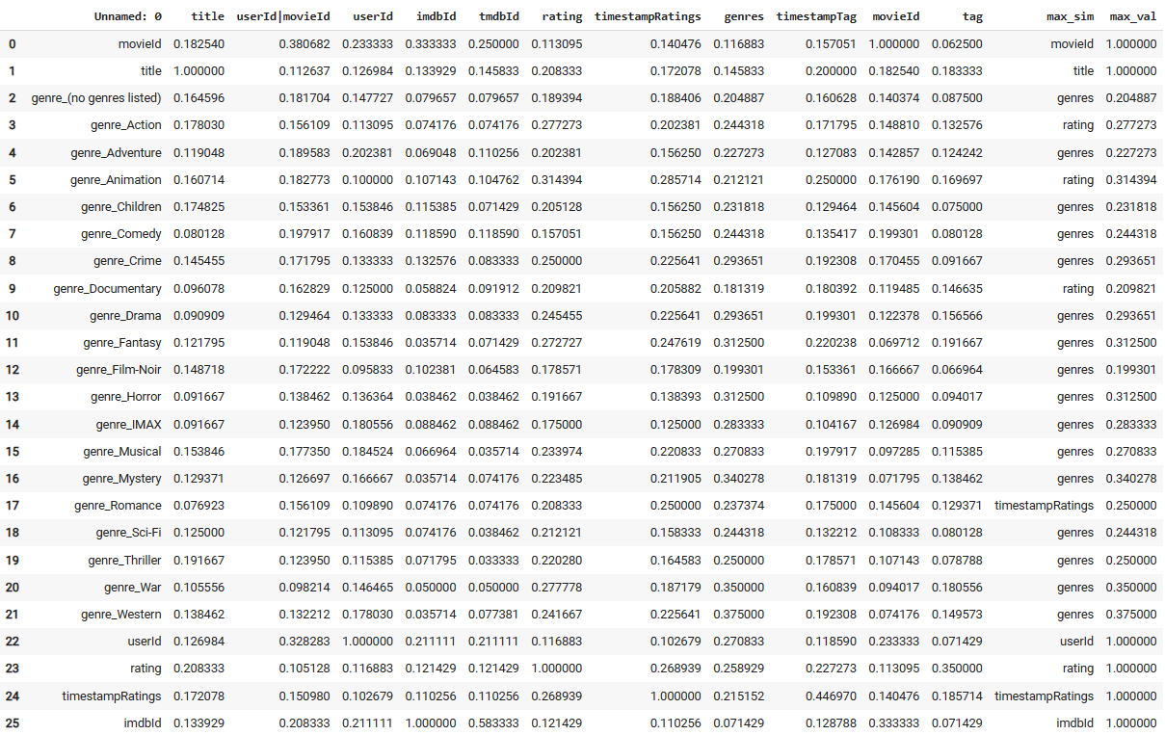
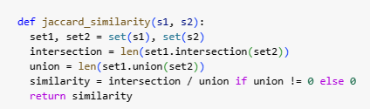
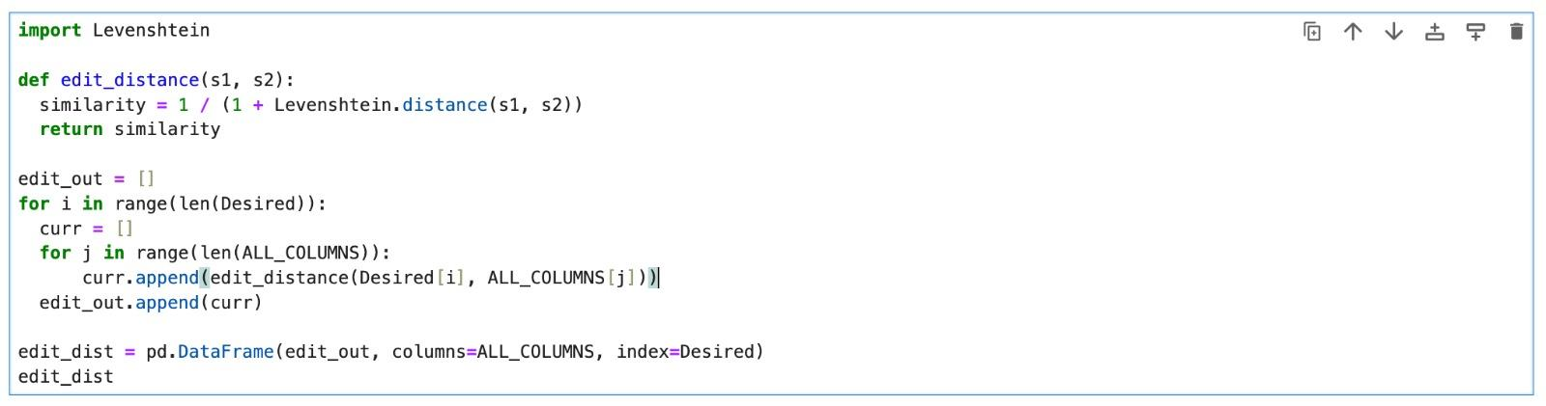
Jaccard and Edit distance column matching
Used Jaccard and edit dist.
to determine the optimal
matches from the source
to the target.
Results leave much to be desired
For genres columns.

Slide 7
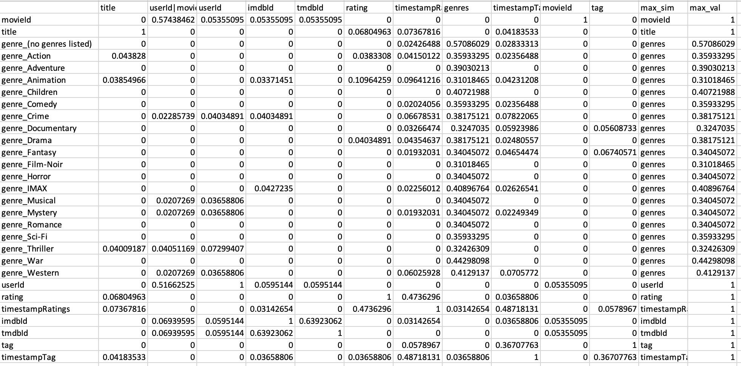
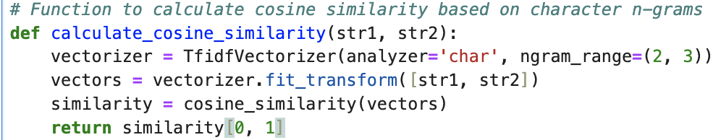
Tf-Idf and cosine similarity for column matching
Using TF-IDF vectorizer followed by cosine-similarity gave good results with all the original columns mapped perfectly to the desired columns

Slide 8


Mapping (GAV) and Integrating
Fix inconsistencies in movies and tags
We can now leverage a one to one mapping form the current schema to the target when integrating

Slide 9
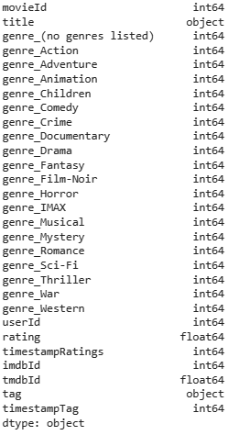
Integration
Joins performed based on movieId and userId

Slide 10
Thank You

